Slide 1
Superposition
Section 4.1, 4.2, 4.3
Md. Shafqat Talukder Rakin
Lecturer, Department of CSE,
United International University
Email id : shafqat@cse.uiu.ac.bd

Slide 2
Learned so far…
Techniques to analyze electrical circuits
KCL & KVL
VDR & CDR
Node analysis
Mesh analysis
Advantage
analyze a circuit without tampering with its original configuration
Disadvantage
for a large, complex circuit, complex computation is involved
The growth in areas of application of electric circuits has led to an evolution from simple to complex circuits

Slide 3


Slide 4
New techniques
Superposition
Thevenin
Norton
…

Slide 5
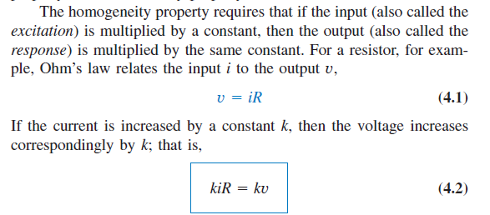
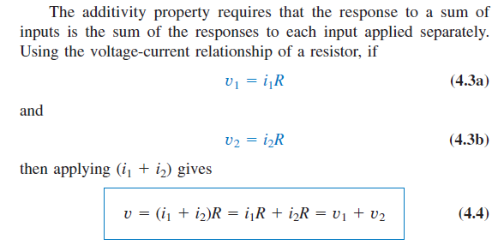
Important concept for superposition
Linearity Property
Linearity is the property of an element describing a linear relationship between cause and effect
Combination of both the homogeneity (scaling) property and the additivity property

Slide 6
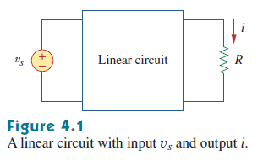
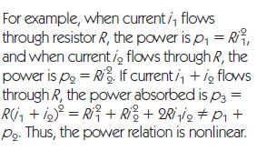
Linear & Non-linear circuits
A linear circuit is one whose output is linearly related (or directly proportional) to its input.
A non linear circuit is one whose output is not linearly related (or directly proportional) to its input.

Slide 7
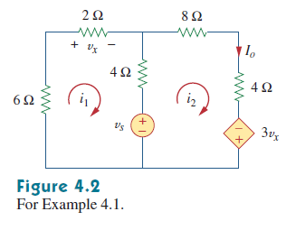
Math Problem Practice:
Reference: Sadiku_Example_4.1

Slide 8
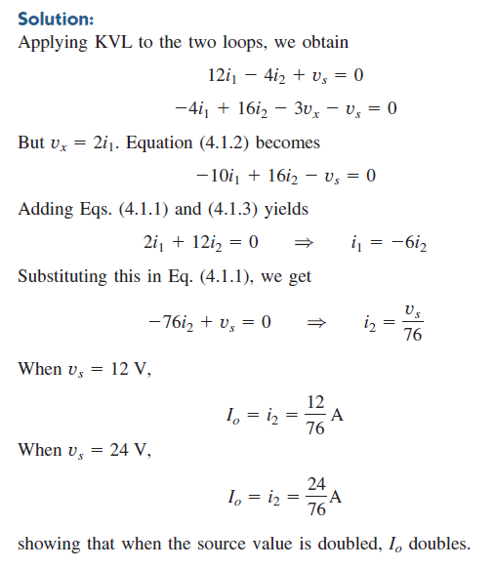
Math Problem Practice:
Reference: Sadiku_Example_4.1

Slide 9
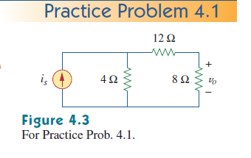

Math Problem Practice:
Reference: Sadiku_Practice_Problem_4.1

Slide 10
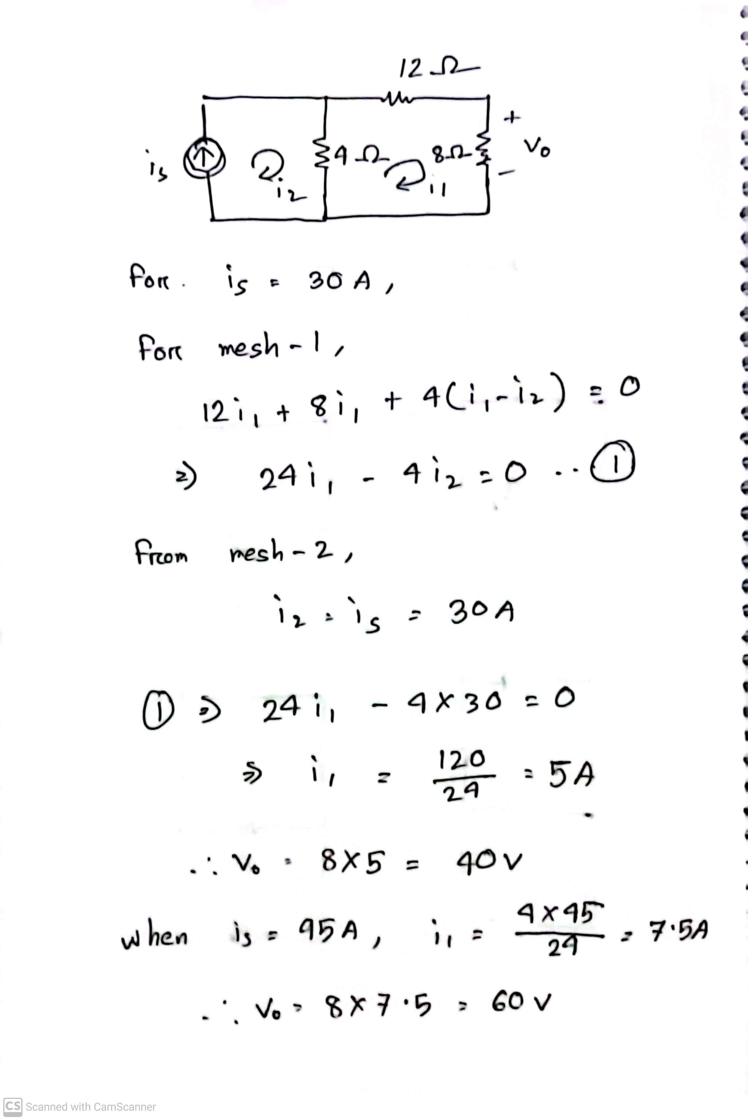
Math Problem Practice:
Reference: Sadiku_Practice_Problem_4.1

Slide 11
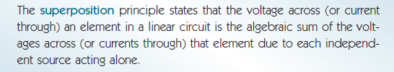
superposition
If a circuit has two or more independent sources, one way to determine the value of a specific variable (voltage or current) is to use nodal or mesh analysis. Another way is to determine the contribution of each independent source to the variable and then add them up. The latter approach is known as the superposition.

Slide 12
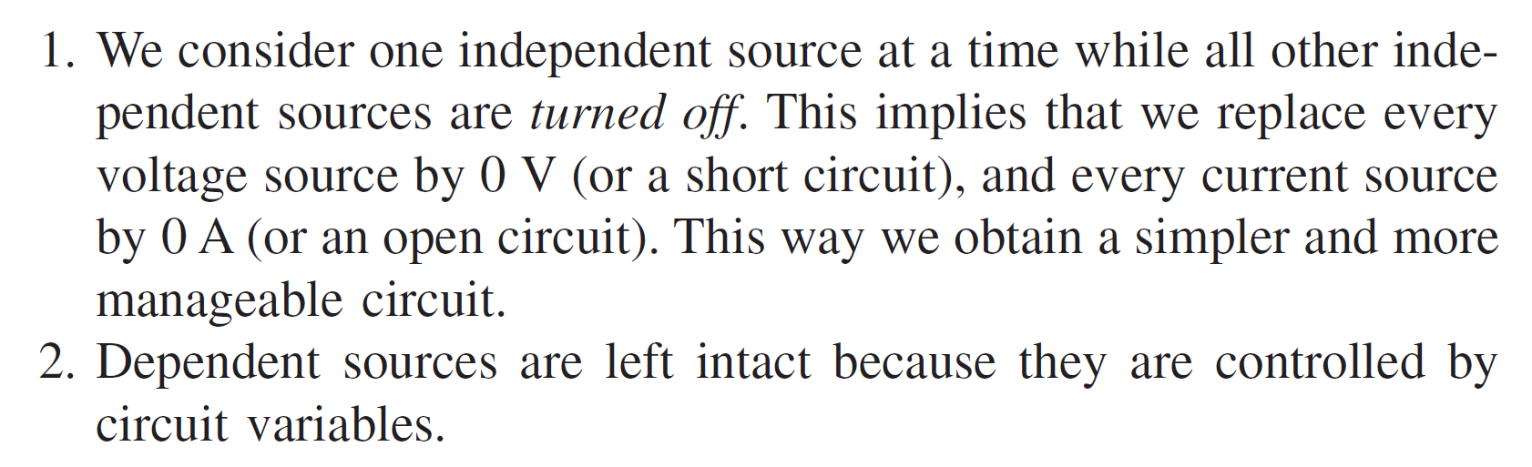
Important points

Slide 13
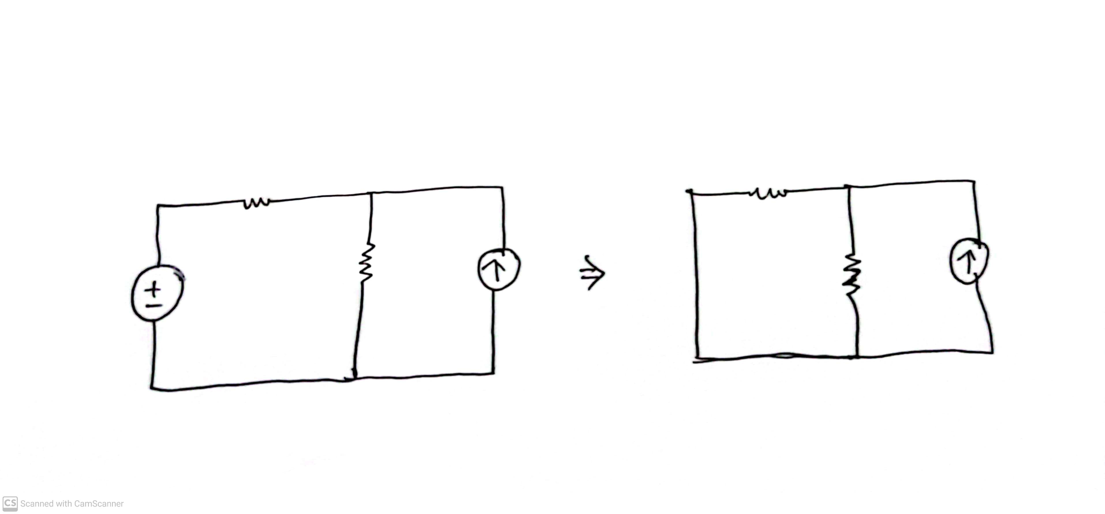
Keep in mind
Voltage source turned off => 0 v => Short circuit =>

Slide 14
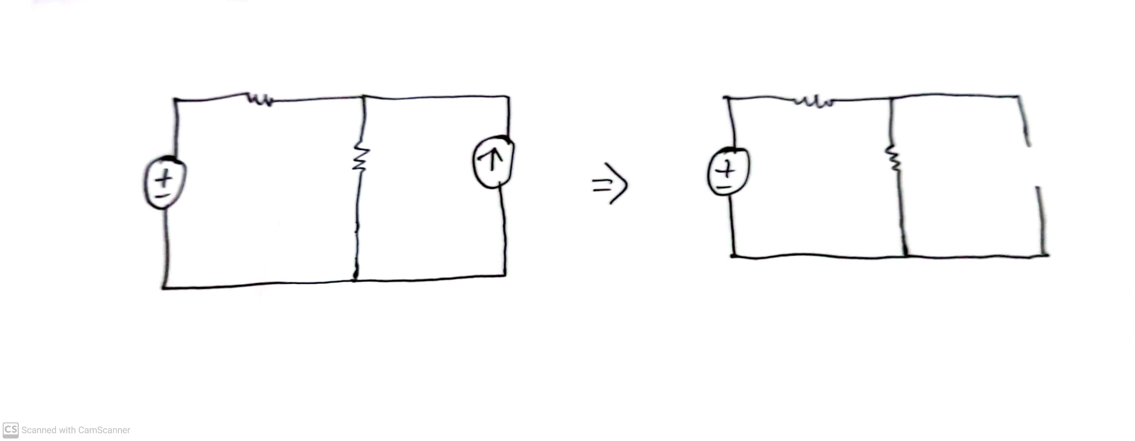
Keep in mind
Current source turned off => 0 A => Open circuit =>

Slide 15
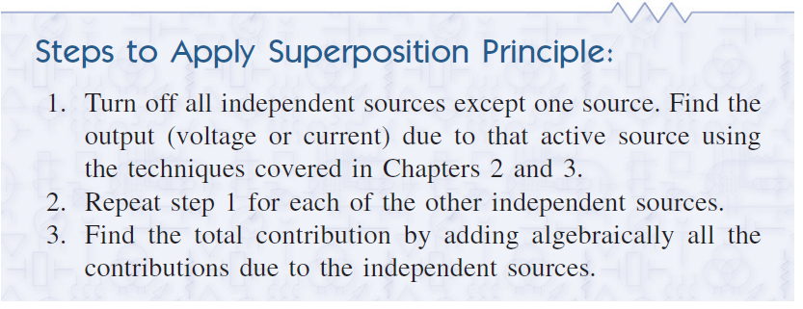
Steps for superposition

Slide 16
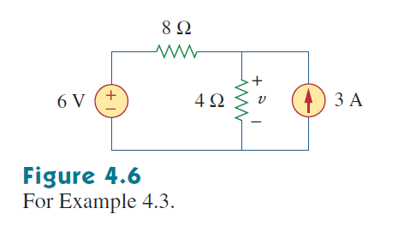
Math Problem Practice:
Reference: Sadiku_Example_4.3

Slide 17
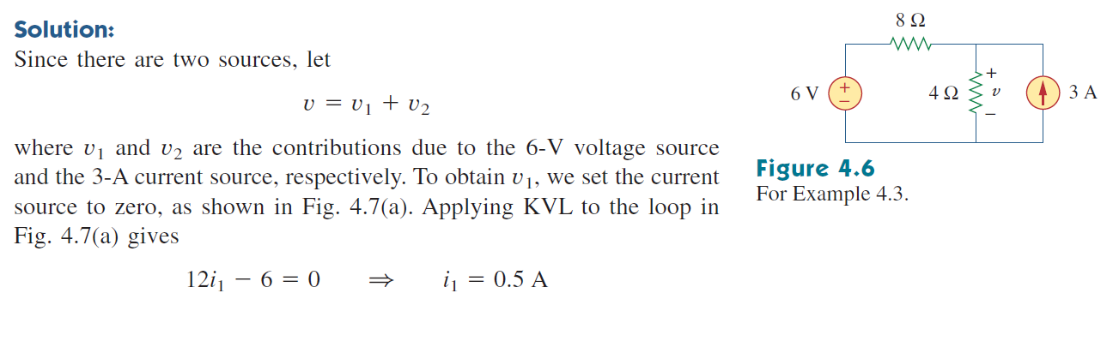
Math Problem Practice:
Reference: Sadiku_Example_4.3

Slide 18
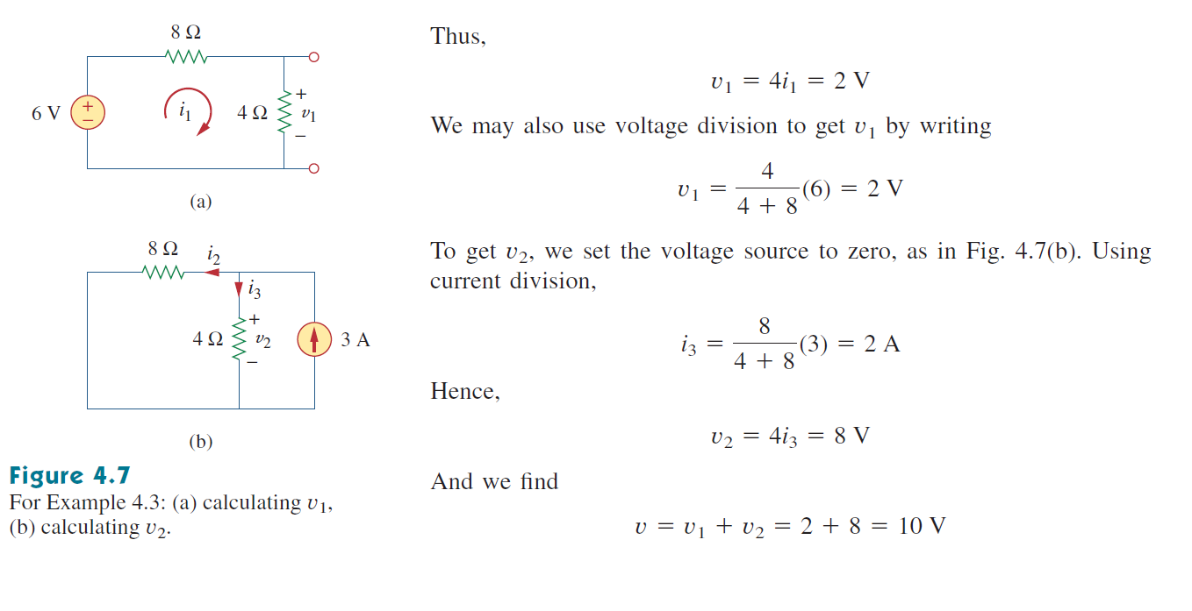
Math Problem Practice:
Reference: Sadiku_Example_4.3

Slide 19
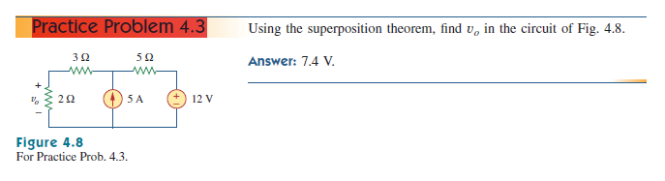
Math Problem Practice:
Reference: Sadiku_Practice_Problem_4.3

Slide 20
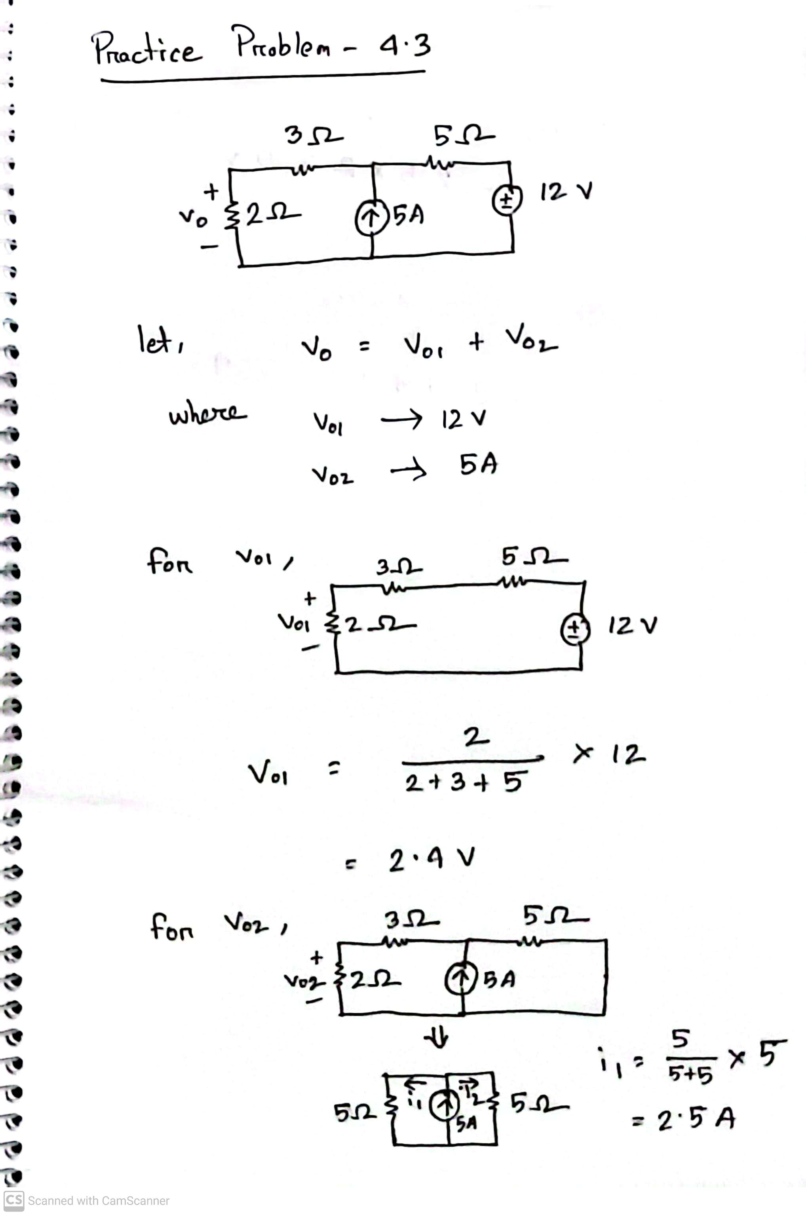
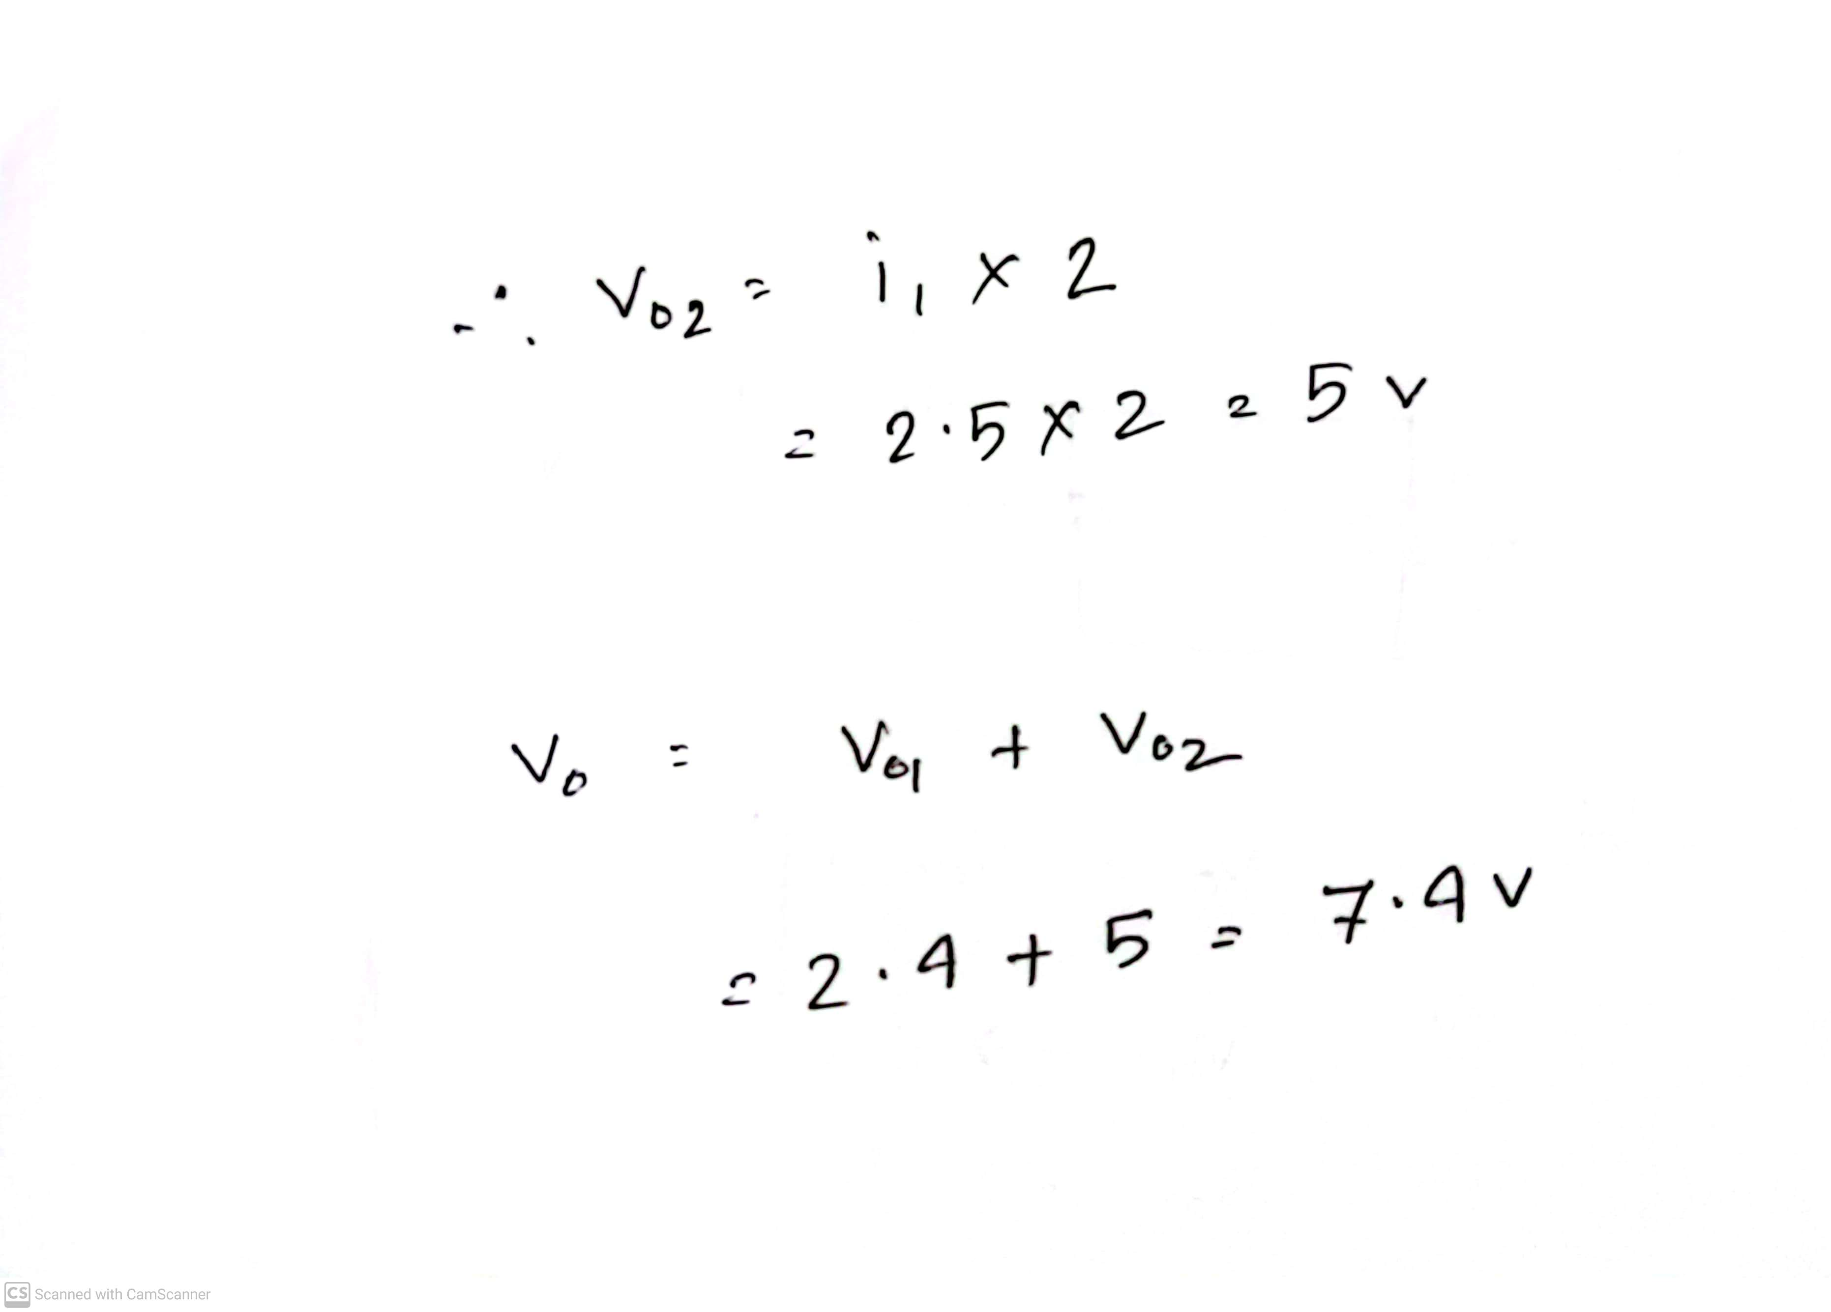
Math Problem Practice:
Reference: Sadiku_Practice_Problem_4.3

Slide 21
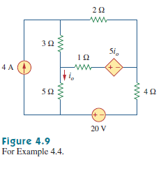
Math Problem Practice:
Reference: Sadiku_Example_4.4

Slide 22
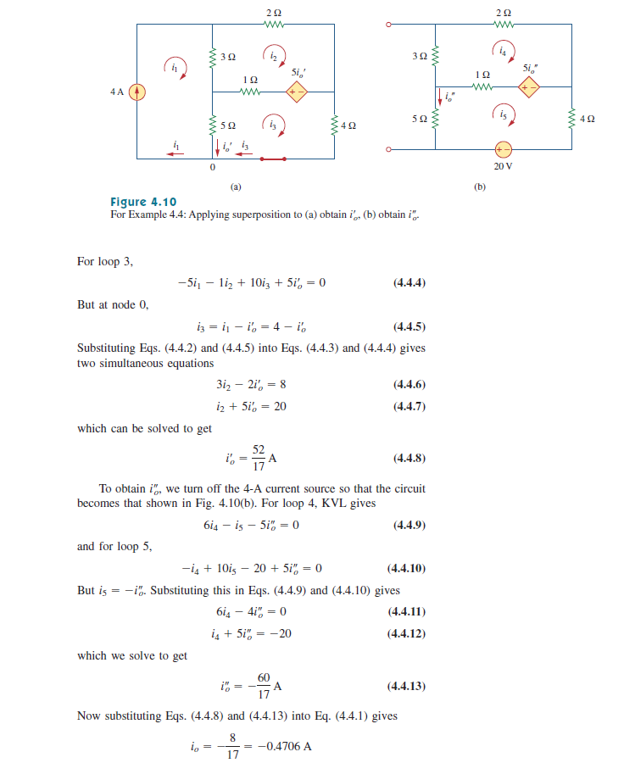
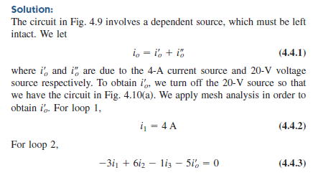
Math Problem Practice:
Reference: Sadiku_Example_4.4

Slide 23
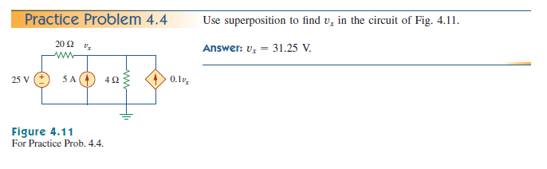
Math Problem Practice:
Reference: Sadiku_Practice_Problem_4.4

Slide 24
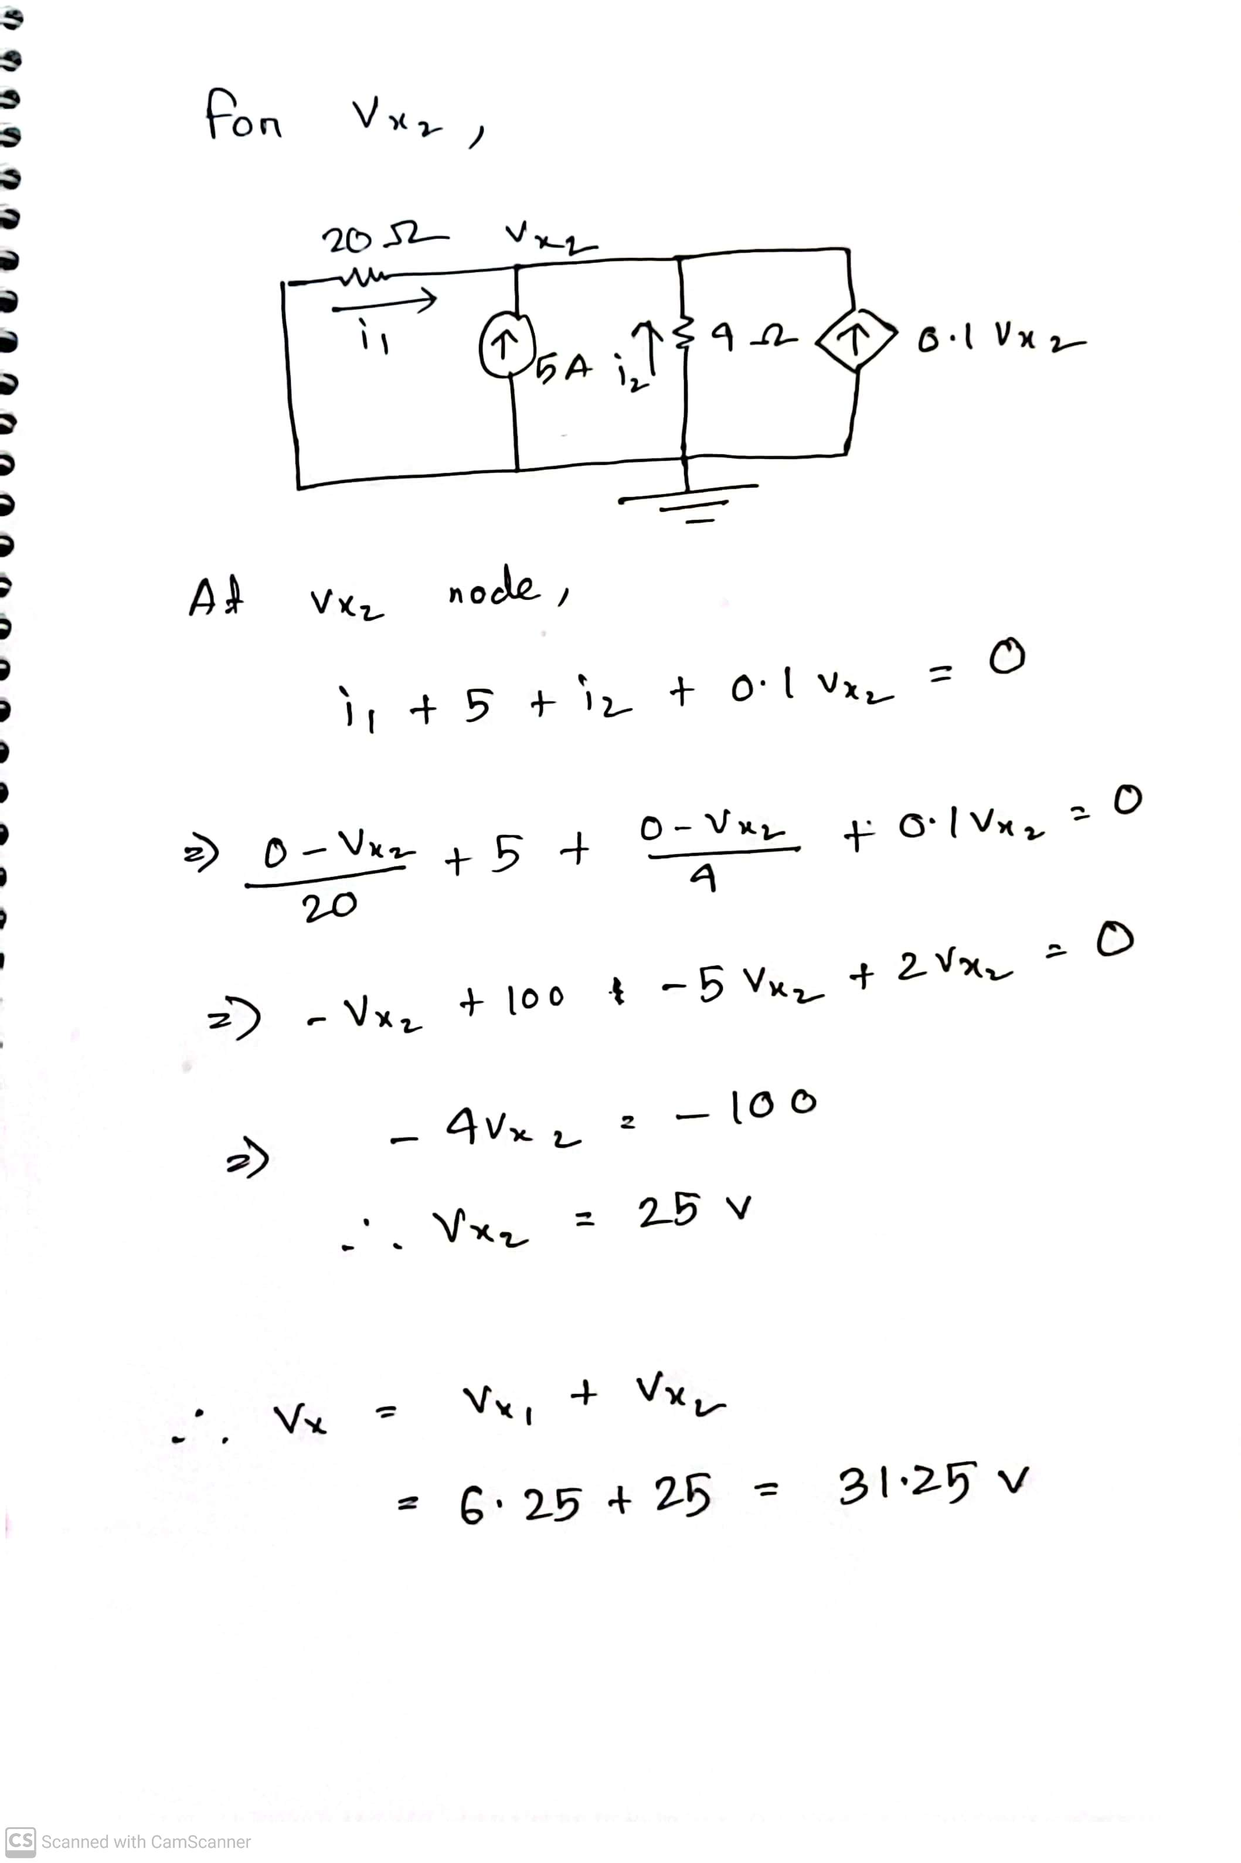
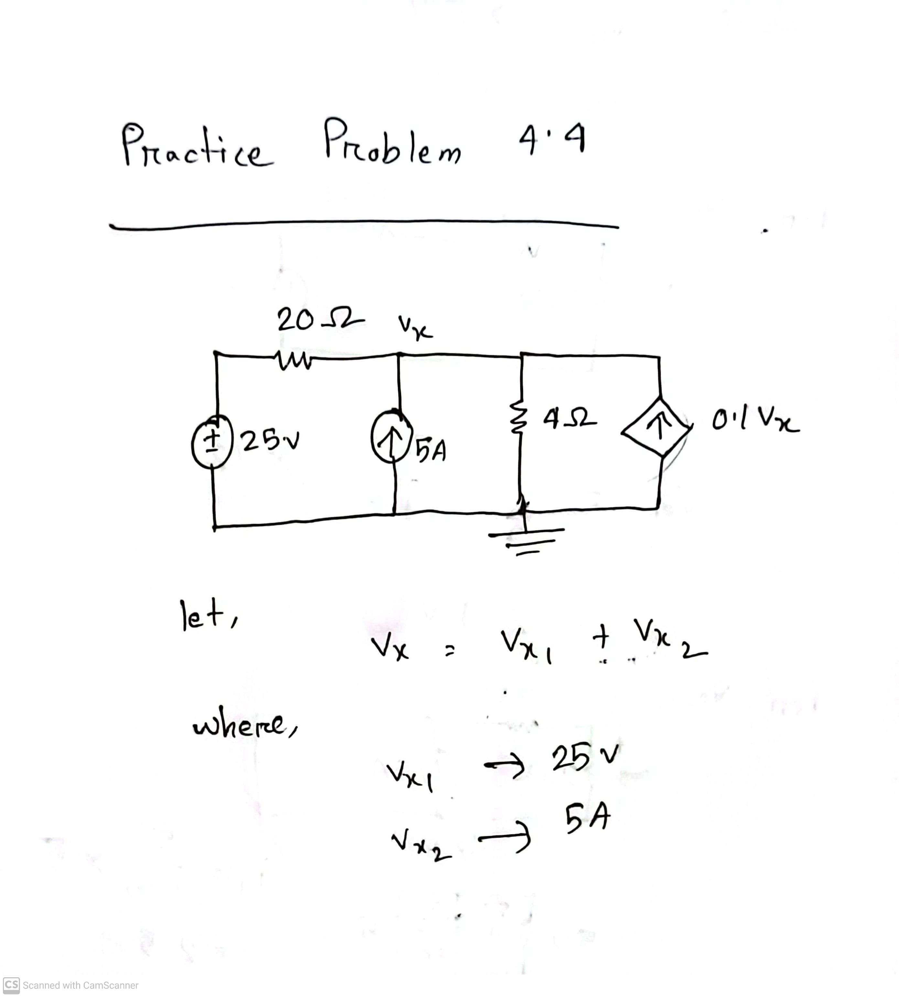
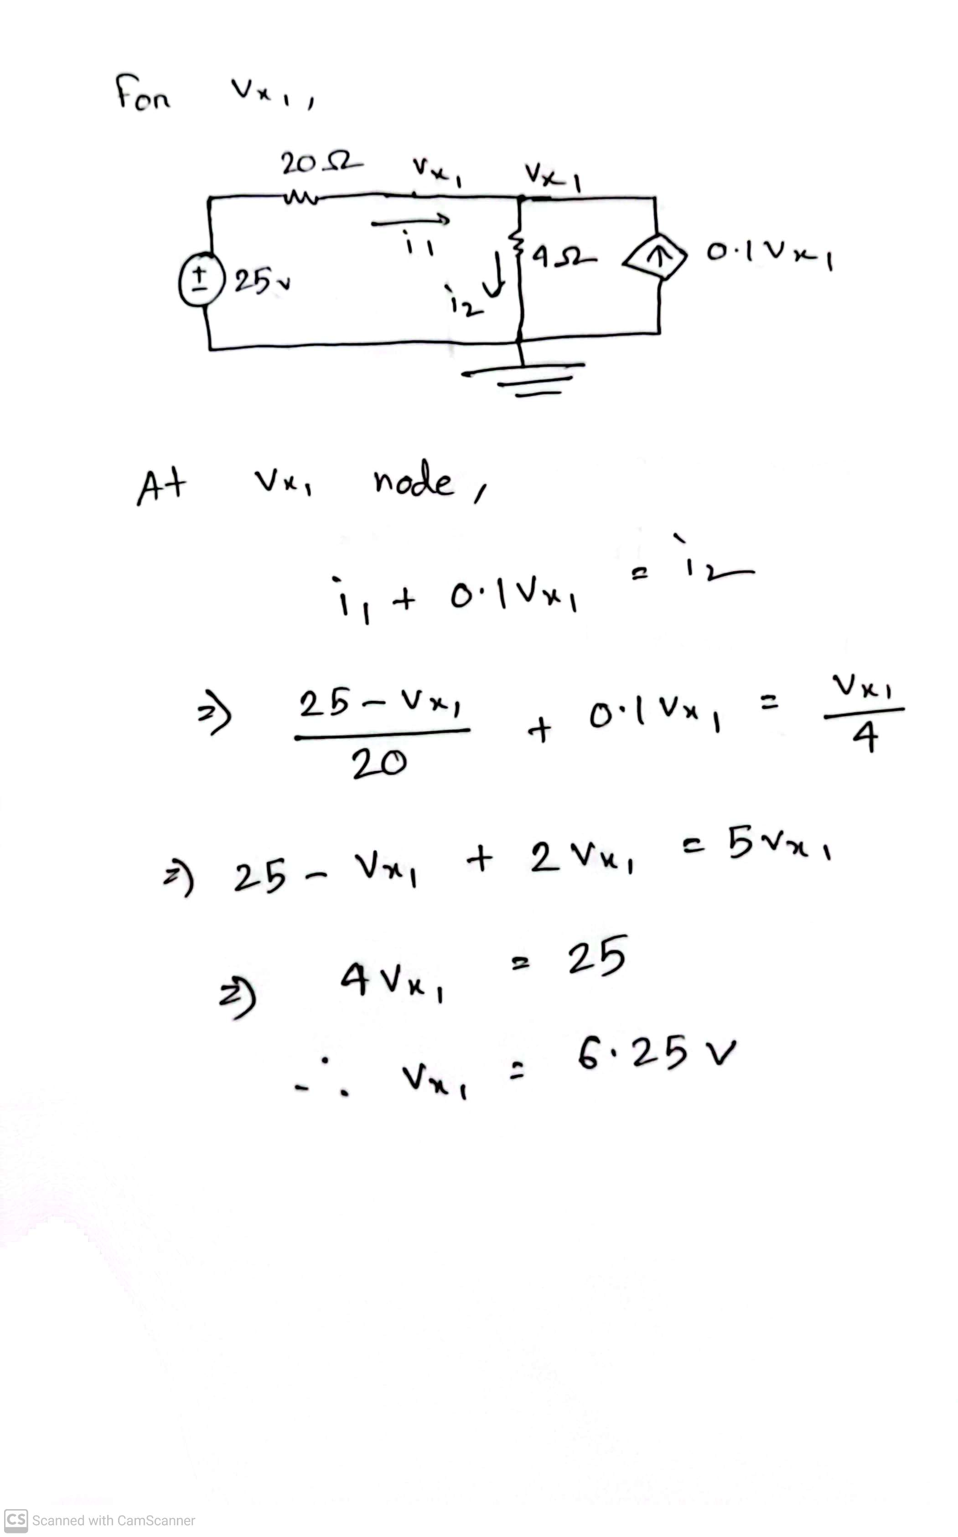
Math Problem Practice:
Reference: Sadiku_Practice_Problem_4.4

Slide 25
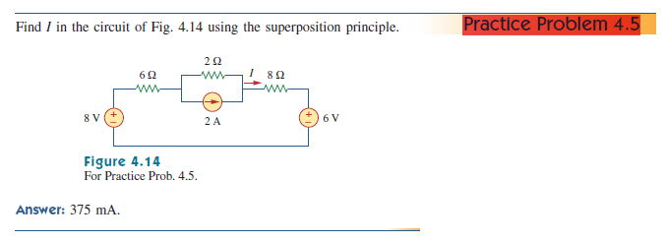
Math Problem Practice:
Reference: Sadiku_Practice_Problem_4.5

Slide 26
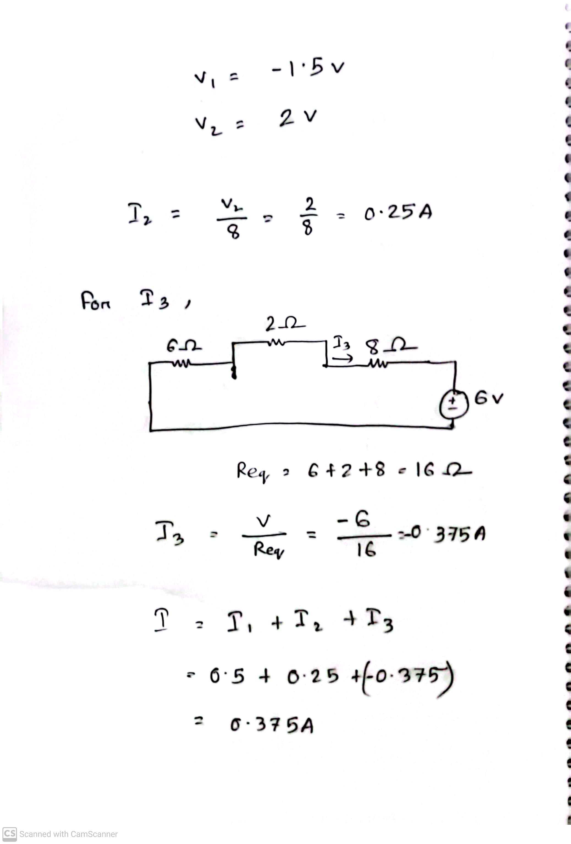
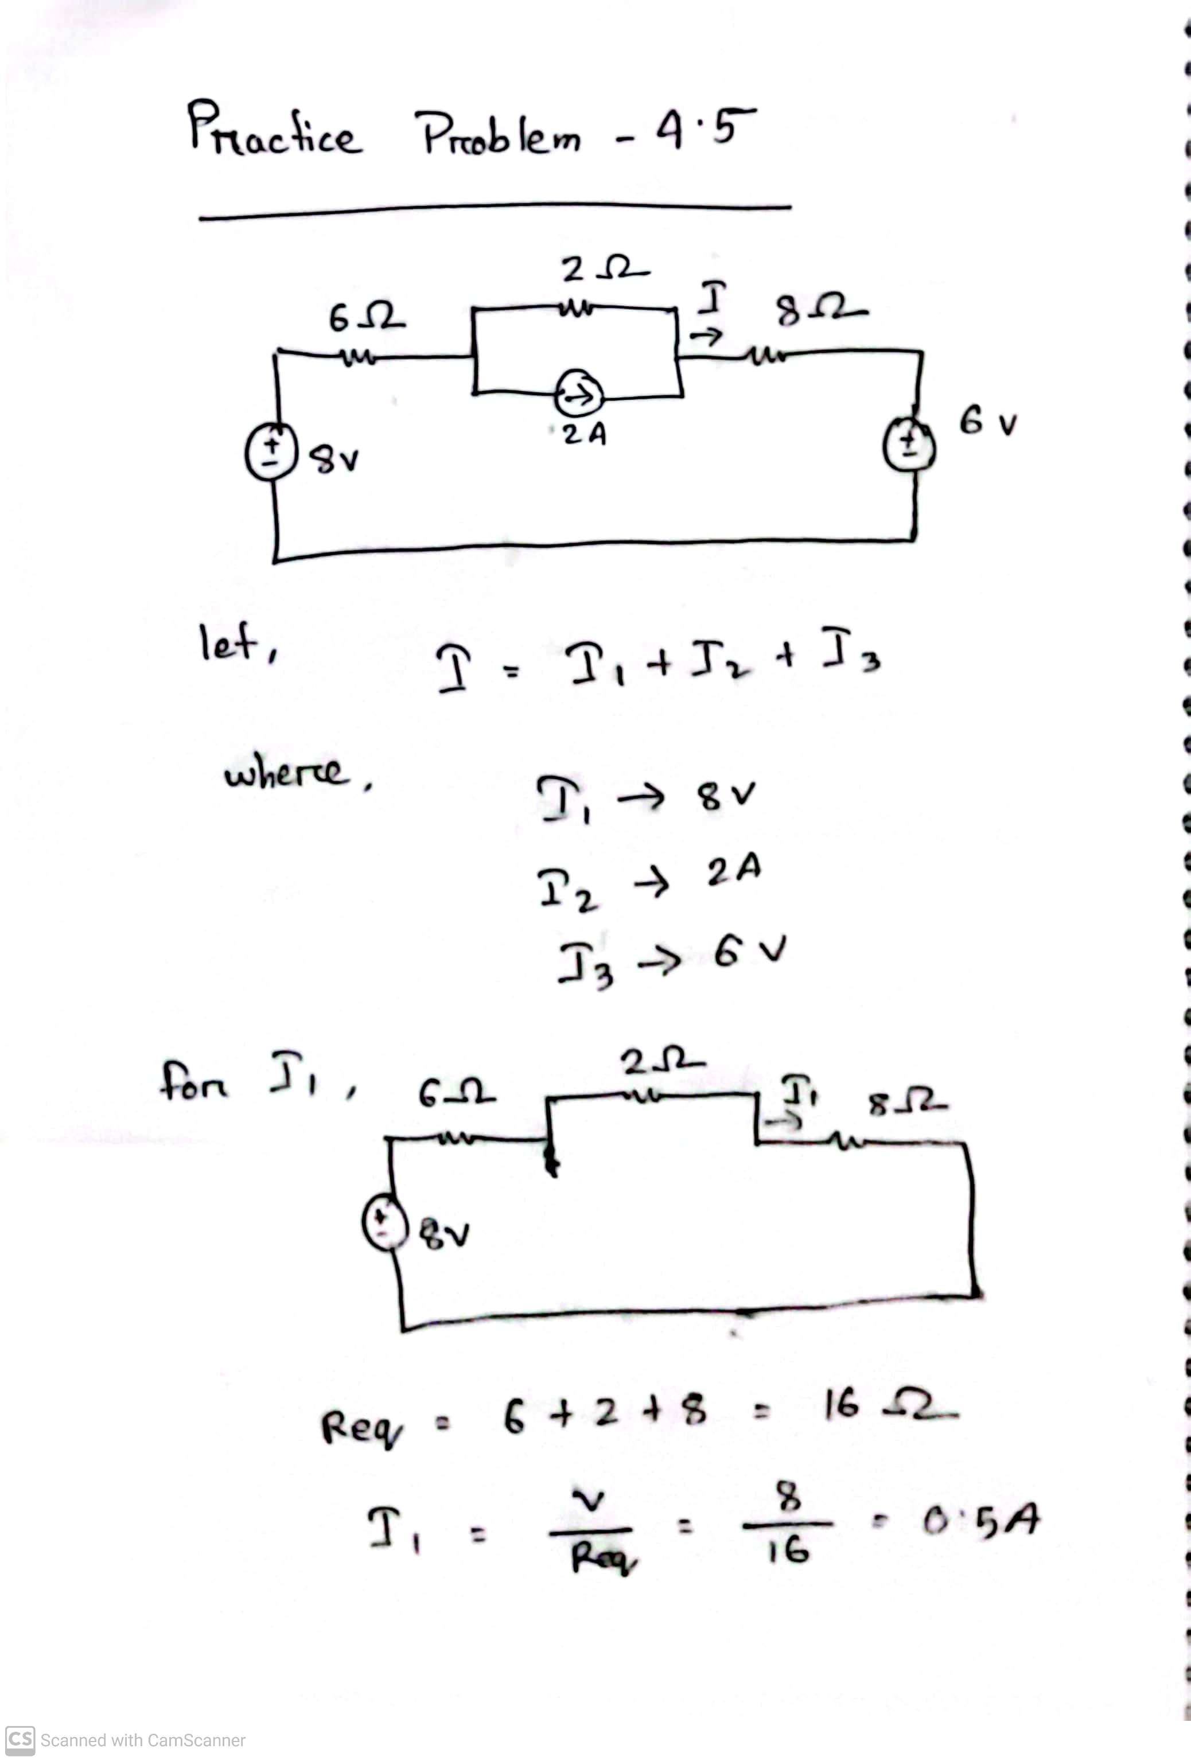
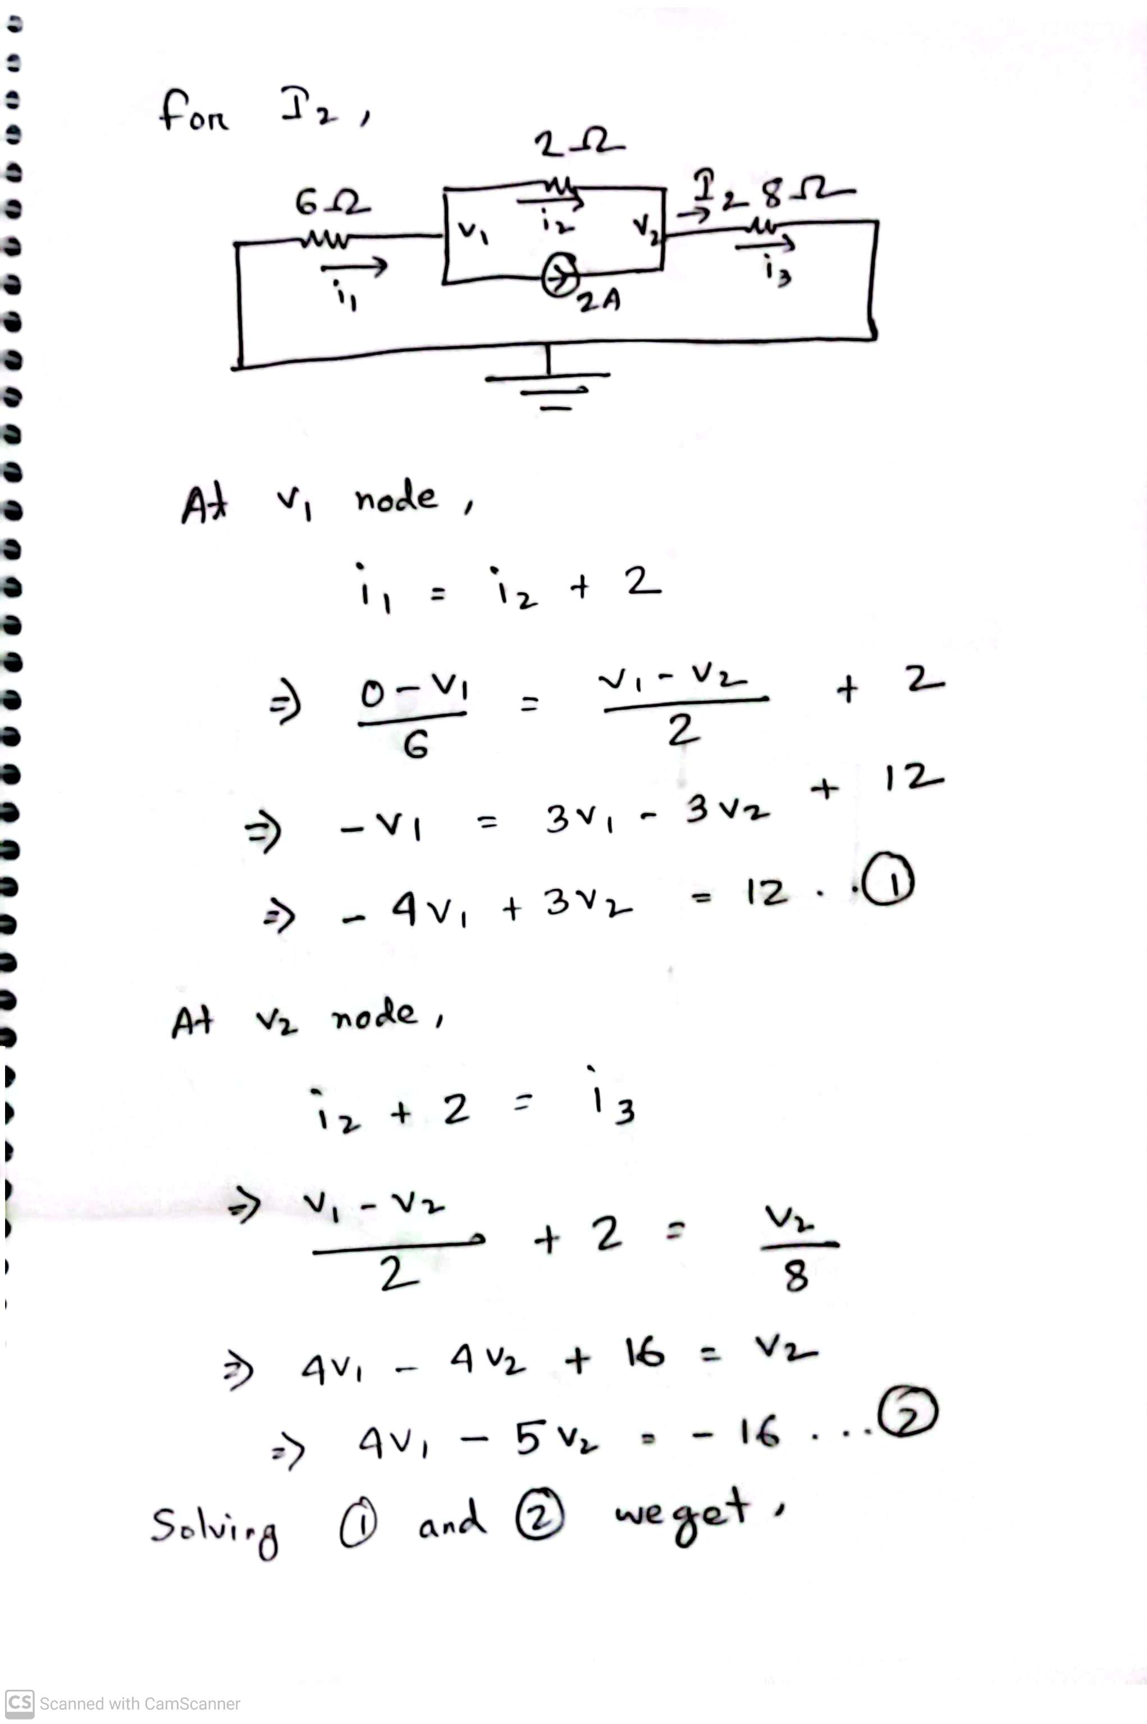
Math Problem Practice:
Reference: Sadiku_Practice_Problem_4.5

Slide 27
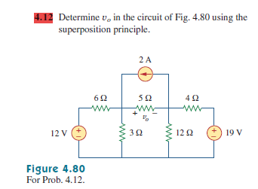
Math Problem Practice:
Reference: Sadiku_Exercise_4.12

Slide 28
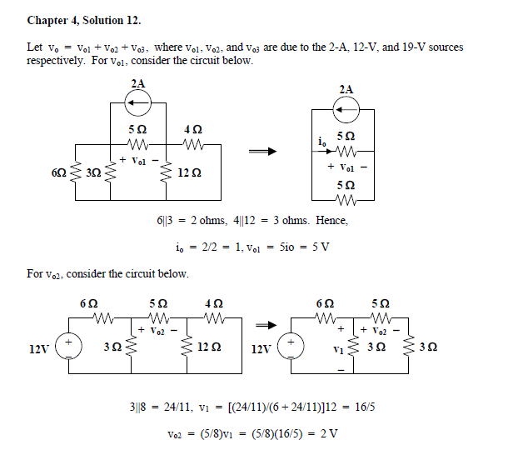
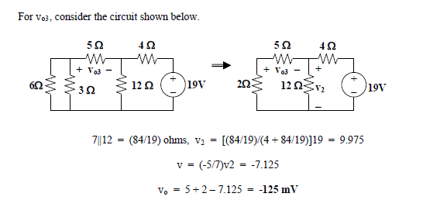
Math Problem Practice:
Reference: Sadiku_Exercise_4.12

Slide 29
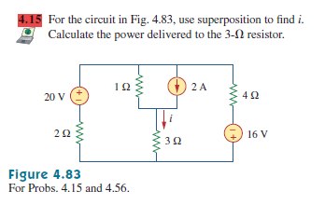
Math Problem Practice:
Reference: Sadiku_Exercise_4.15

Slide 30
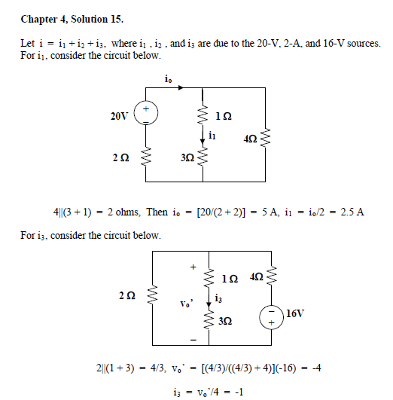
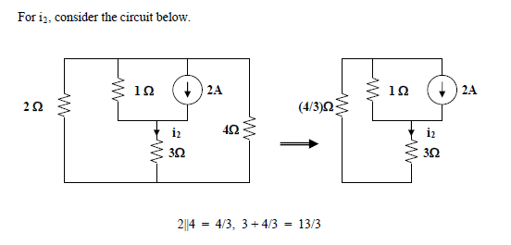
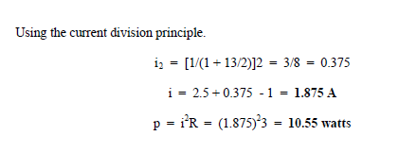
Math Problem Practice:
Reference: Sadiku_Exercise_4.15

Slide 31
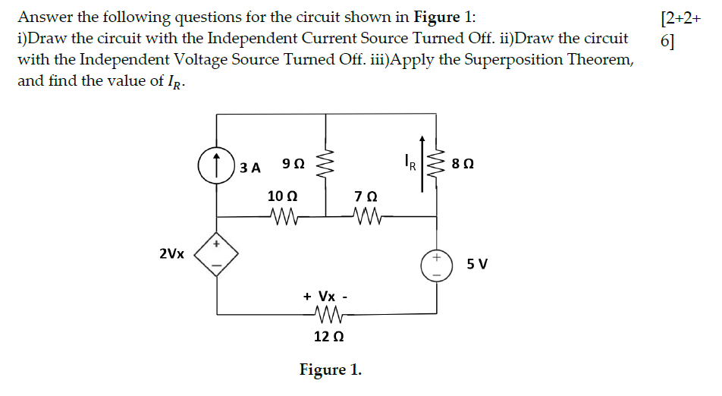
Fall 2023

Slide 32
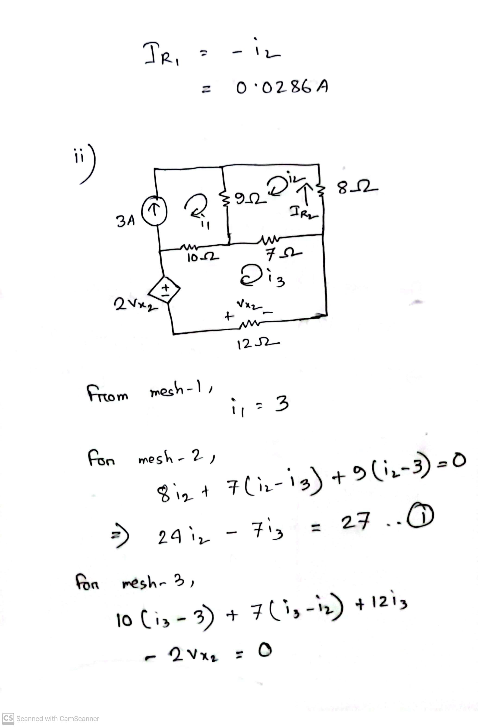
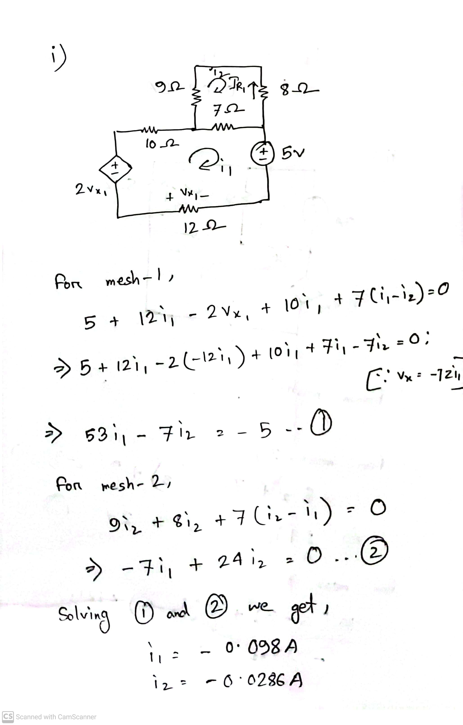
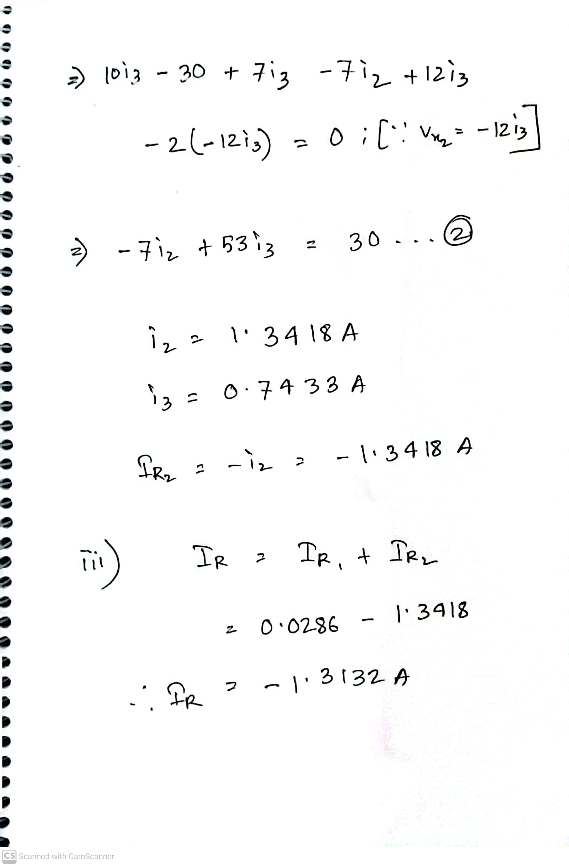
Fall 2023

Slide 33
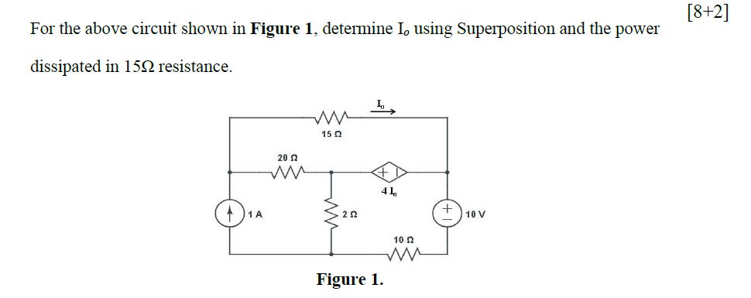
Summer 2023

Slide 34
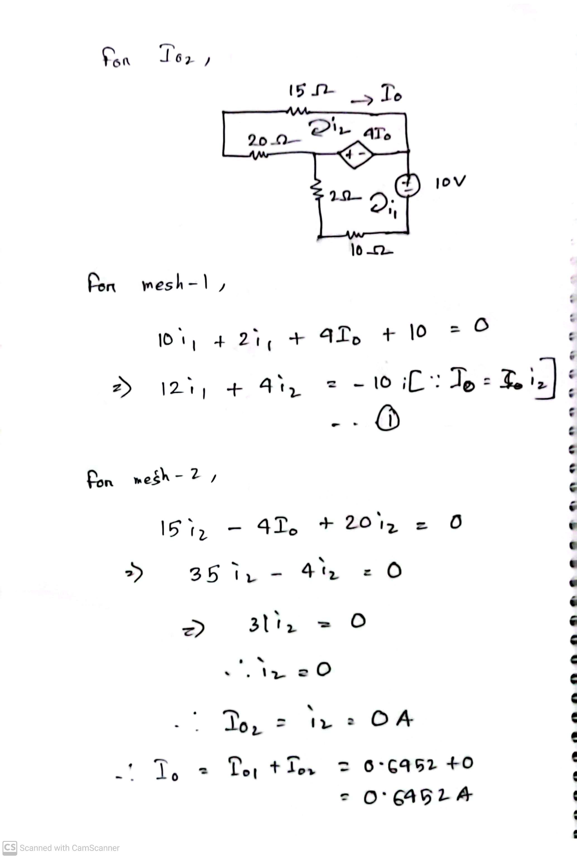
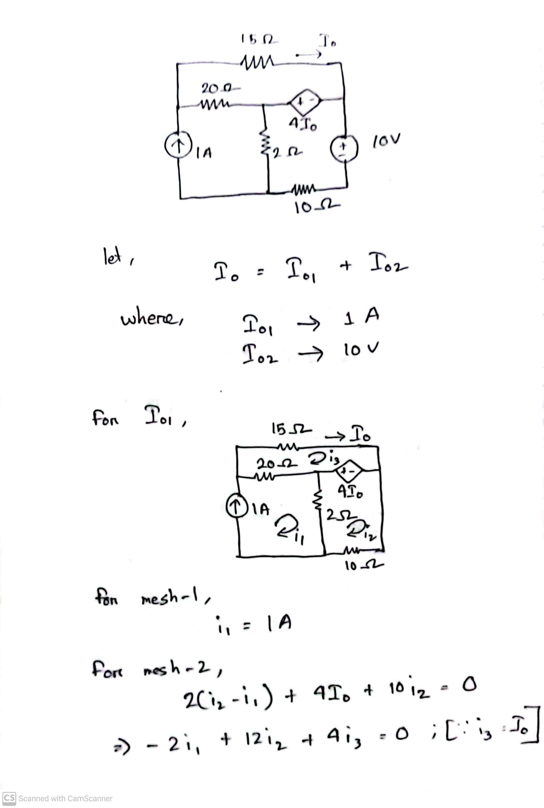
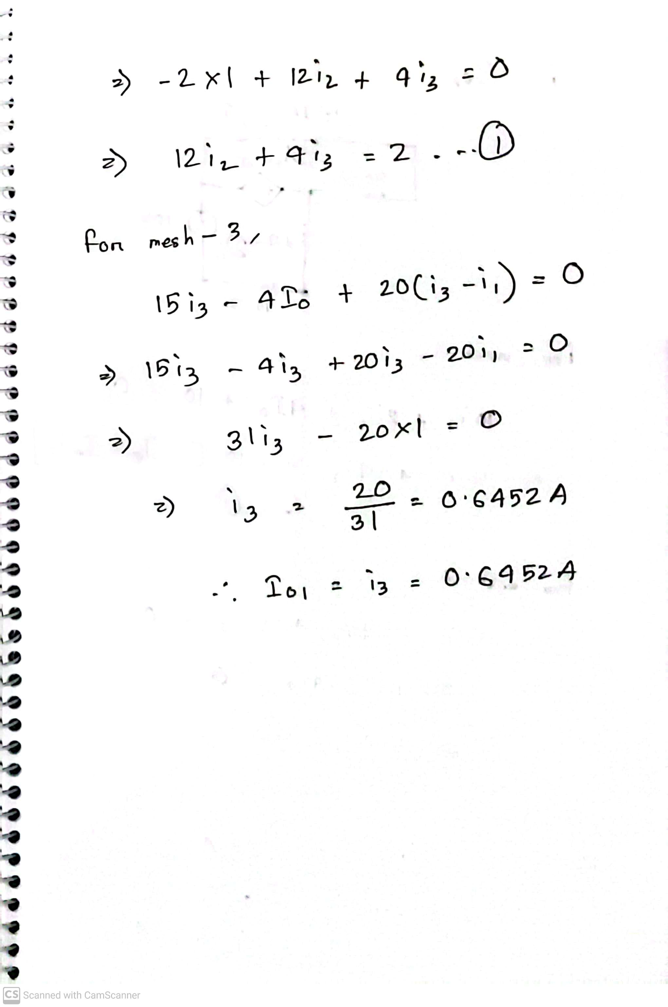
Summer 2023

Slide 35
Math to Practice from the Book for Exam
Superposition
Example:
4.3, 4.4, 4.5
Practice Problem:
4.3, 4.4, 4.5
Problem:
4.8, 4.9, 4.11, 4.12, 4.13, 4.14, 4.15, 4.16, 4.17, 4.18, 4.19, 4.24, 4.25, 4.26, 4.27, 4.38, 4.43

Slide 36
Thank you

